Slide 1

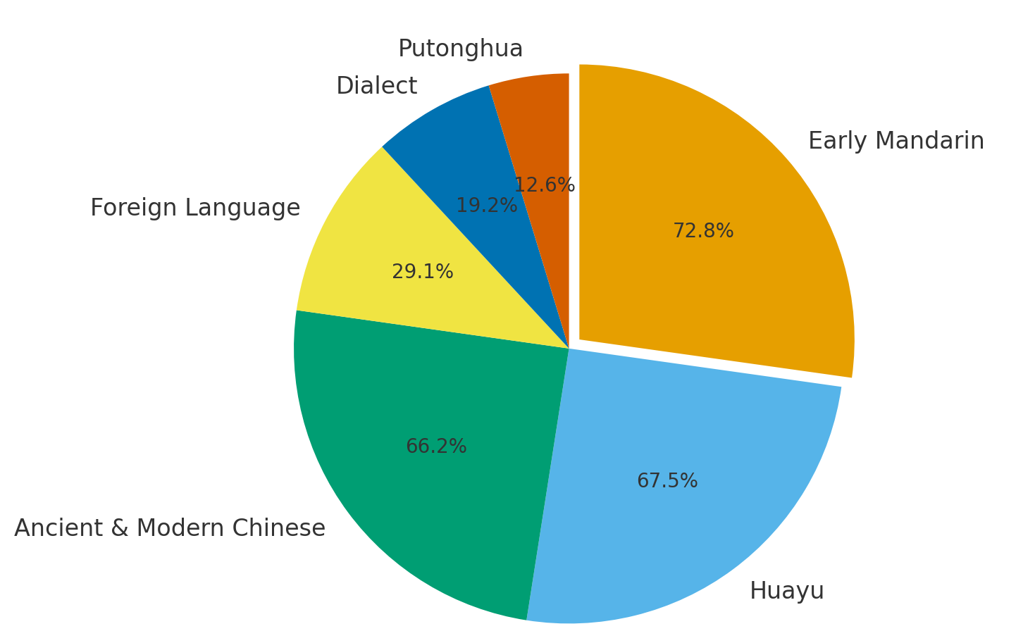
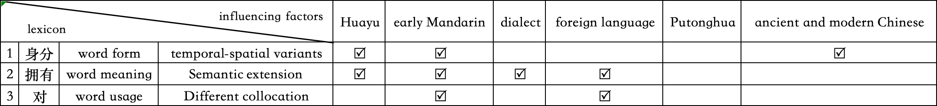
INSERT YOUR PAPER ID HERE
Lexical Usage Characteristics in the Malaysian Chinese Language from a Global Chinese Perspective
ZHANG YUTONG, SUPERVISOR NAME
Department of Chinses Studies, Faculty of Arts and Social Sciences, Universiti Malaya, Kuala Lumpur, Malaysia
INTRODUCTION
This study applied Diao Yanbin’s (2022) “Six Perspectives” framework—Huayu, Early Mandarin, Dialect, Foreign Language, Putonghua, and Ancient and Modern Chinese—to examine lexical differences between the Malaysian Chinese language and Putonghua. Using Sin Chew Daily news (Jan–Mar 2025), the study found that all six perspectives influenced Malaysian Chinese to varying degrees.
RESULTS AND DISCUSSION
• Significant lexical differences were found between the Malaysian Chinese language and Putonghua in word form, meaning, and usage.
• Major influences came from Early Guoyu, Huayu, and Classical/Early Modern Chinese.
• The Malaysian Chinese lexicon shows systematicity, inheritance, evolution, and multi-sourcedness, with a clear tendency toward disyllabification.
RESEARCH SIGNIFICANCE
Filled a research gap in the systematic study of lexical usage in the Malaysian Chinese language.
Applied Diao Yanbin’s (2022) “Six Perspectives” theory for the first time in Malaysian Chinese language research.
METHODOLOGY
Theoretical Framework
Adopted Diao Yanbin’s (2022) Six Perspectives theory as the analytical foundation.
Research Methods
• Corpus Analysis: Based on Sin Chew Daily news (Jan–Mar 2025) written by Malaysian local journalists.
• Comparative Analysis: Examined lexical differences between the Malaysian Chinese language and Putonghua.
• Inductive Analysis: Categorized findings into word form, meaning, and usage, summarizing the lexical features and formative causes of the Malaysian Chinese language.
Fig. 2. Proportion of Influences on the Malaysian Chinese Lexicon
CONCLUSIONS
This study was the first to apply Diao Yanbin’s Six Perspectives framework to Malaysian Chinese language research, confirming its theoretical suitability.
It highlighted the unique lexical features of Malaysian Chinese and promoted diversity and inclusiveness within the Global Huayu community.
REFERENCES
Diao Yanbin (2022a). Six Perspectives on the Study of Chinese Language. Folklore, Classics and Scripts, (2), 257-272.
Guo Xi (2004). On "Hua Yu". Journal of the School of Chinese Language Jinan University, (2), 56-65.
Table 1. Examples of Lexical Differences and Their Influencing Factors

